Slide 1

Spatio-temporal Mobility Summary using Location Traces
Manasa J M
Master of Science (by Research)
Under the supervision of
Dr. Soumya K Ghosh and Dr. Vinay Kolar (IBM Research)
Department of Computer Science and Engineering
Indian Institute of Technology, Kharagpur

Slide 2
Overview
Introduction
Problem Definition
Motivation
Objectives
Literature Survey
Trajectory Preprocessing
Trajectory Similarity
Trajectory Clustering
Experimentation
Conclusion and Future Work
M.S First Seminar

Slide 3
Introduction
Problem Definition, Motivation, Objectives
M.S First Seminar

Slide 4
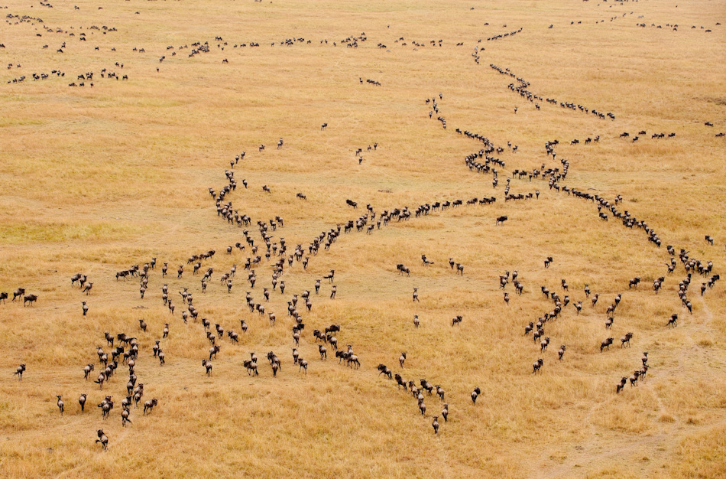

Mobility Data of people collected at a large scale
Various sources of data – GPS traces, Call Detail Records, Location Based Social Networks
Analysis at both individual and community level is possible
Other applications of trajectory mining includes animal cluster movement prediction, hurricane movement, etc
Animal Movement Pattern
Satellite image showing the trajectories of 380 taxi trajectories in London
http://www.bbc.co.uk/britainfromabove/stories/visualisations/taxis.shtml - See more at: http://flowingcity.com/visualization/taxis-in-london-2/#sthash.btyeKW7B.dpuf

Slide 5






Problem Definition
Mobility Summary of an individual define the frequent paths taken by the user.
.
Raw GPS Traces
.
.
Mobility Summary framework
Mobility Summary of a user
M.S First Seminar

Slide 6



Motivation
Mobility Summary represents the movement pattern of a user
Queries on the mobility of a person need not deal with all the trajectories
Provides as an abstraction to the user’s movement.
Queries based on mobility summary include -
Users who frequently pass through a given place ( ex- Coffee shop)
Next path prediction
Anomaly Detection
M.S First Seminar

Slide 7
Objectives
Trajectory Preprocessing
Trajectory Similarity Analysis
Trajectory Clustering
Trajectory Summarization
Applications of Mobility Summary
M.S First Seminar

Slide 8
Literature Survey
M.S First Seminar

Slide 9
Trajectory Preprocessing
Authors | Work | Contribution
Li, Zheng et al. 2008 | Mining user similarity based on location history -SIGSPATIAL | Algorithm for Stay point detection
Zheng and Xie 2011 | Learning travel recommendations from user-generated GPS traces- TIST | Uses of stay point to define a trip
Yu Zheng 2015 | Trajectory Data Mining: An Overview- TIST | Trajectory segmentation
Trajectory Similarity Analysis
Authors | Work | Contribution
Berndt et al. 1996 | Finding patterns in time series- AAAI | Introduced Dynamic Time Warping similarity
Chen et al. 2005 | Robust and fast similarity search for moving object trajectories - SIGMOD | Introduced Edit Distances on Real Sequences(EDR) similarity
Chen et al. 2004 | On the marriage of LP-norms and edit distance- VLDB | Introduced Edit Distance with Real Penalty(ERP) similarity
Wang et al 2013 | An effectiveness study on trajectory similarity measures - ADC | Comparison of six widely used similarity measures
M.S First Seminar

Slide 10
Trajectory Clustering
Authors | Work | Contribution
Nanni et al. 2006 | Time-focused clustering of trajectories of moving objects - JIIS | Proposed a density based clustering algorithm
Zhang et al. 2014 | Clustering spatio-temporal trajectories based on kernel density estimation-ICCSA | Kernel density estimation based approach for clustering
Han et al. 2012 | Neat: Road network aware trajectory clustering- ICDCS | Clustering after map matching
Sub-Trajectory Clustering
Authors | Work | Contribution
Li et al. 2010 | Swarm: Mining relaxed temporal moving object clusters - VLDB | Moving Clusters and Detecting closed Swarms
Lee et al. 2007 | Trajectory clustering: A partition-and-group framework - SIGMOD | Partitioning the sub-trajectories and grouping them as a whole
Representative Trajectory
Authors | Work | Contribution
Buchin et al. 2013 | Median Trajectories -Algorithmica | Different ways to find the representative or median trajectory for a cluster
M.S First Seminar

Slide 11
Work Done
M.S First Seminar

Slide 12
Trajectory Preprocessing
Trajectory Preprocessing
Trajectory Similarity Analysis
Trajectory Clustering
Trajectory Summarization
Applications of Mobility Summary
Trajectory cut, Normalization
M.S First Seminar

Slide 13
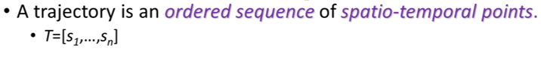
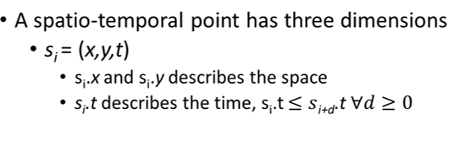
Trajectory
T
0,0,0
0,50,60
0,100,100
M.S First Seminar

Slide 14
Trajectory Cut
Raw GPS Traces
<lat,lon,time>
Collection of Meaningful Trajectories
TrajCut Module
De-Noising
Stay Point Detection
Segmentation
Stitching
M.S First Seminar

Slide 15
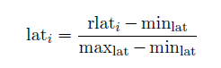
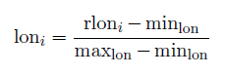
Normalization
Each of the <lat, lon> pairs in the trajectory has to be normalized
Small differences in latitude and longitude can cause great differences on distances.
Trajectory
Normalization Module
Normalized Trajectory
Symbol | Explanation
rlat_{i} , rlon_{i} | Raw lat, raw lon
lat_{i} , lon_{i} | Normalized lat, lon
min_{lat} , min_{lon} , max_{lat} , max_{lon} | Bounding box of the user’s trajectories
Normalized latitude | Normalized longitude
M.S First Seminar

Slide 16
Trajectory Similarity Analysis
Trajectory Preprocessing
Trajectory Similarity Analysis
Trajectory Clustering
Trajectory Summarization
Applications of Mobility Summary
Weighted Curve Distance, DTW
M.S First Seminar

Slide 17
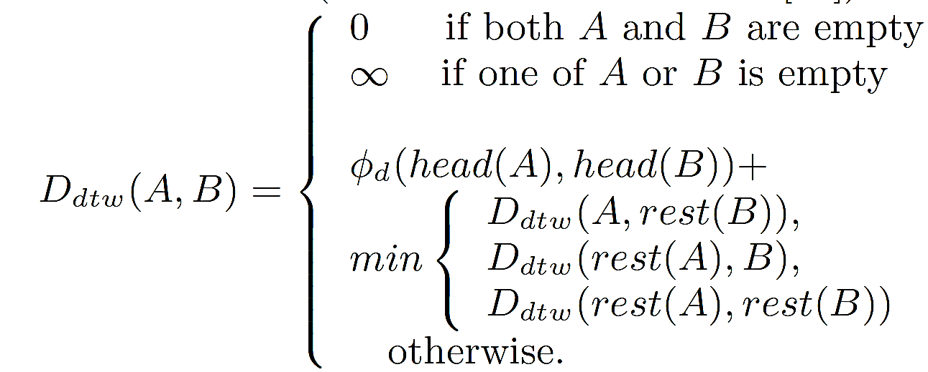
Trajectory Similarity: Dynamic Time Warping (DTW)
φ_{d} (p1,p2)=L₂(p1,p2)
Stretch A
Stretch B
A
Every point in A has to be matched to some point in B
B
B. kee Yi, H. V. Jagadish, and C. Faloutsos. Efficient Retrieval of Similar Time Sequences Under Time Warping. In ICDE, 1998.

Slide 18
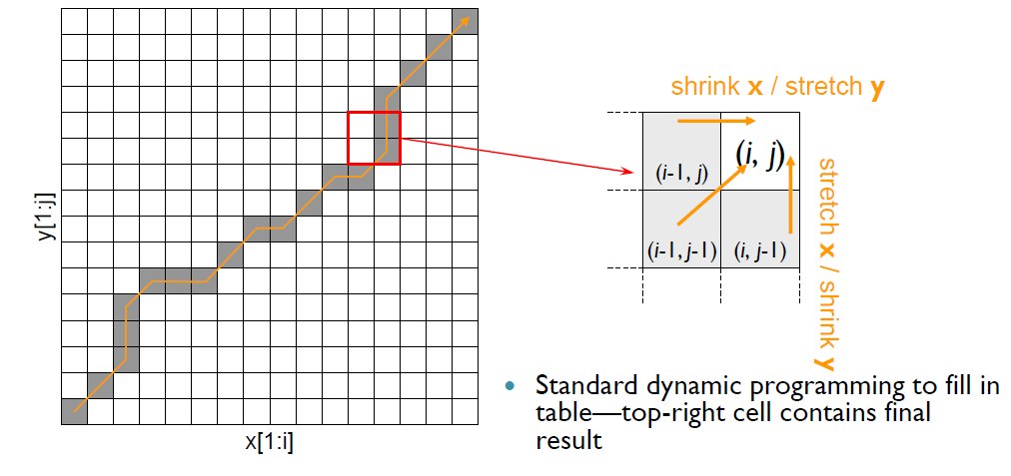
DTW: Computation using Dynamic Programming
Examine all paths
Optimal matching is path connecting the two corners
M.S First Seminar

Slide 19

Proposed Method: Motivation
We want to capture human mobility
Humans have an intention behind the trips the make unlike hurricanes and animal movement
This can be captured by giving more weightage to origin and destination
M.S First Seminar

Slide 20
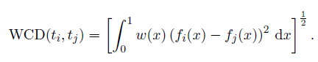
Proposed Method
User’s Trajectories
Weighted Curve Distance Similarity
n x n Similarity Matrix
Resample the Trajectories into N points
Normalize the sample points
Take pointwise LP Norm with giving more weight to the points closer to the origin and destination
M.S First Seminar

Slide 21
Trajectory Clustering
Trajectory Preprocessing
Trajectory Similarity Analysis
Trajectory Clustering
Trajectory Summarization
Applications of Mobility Summary
Hierarchical clustering, optimal point
M.S First Seminar

Slide 22
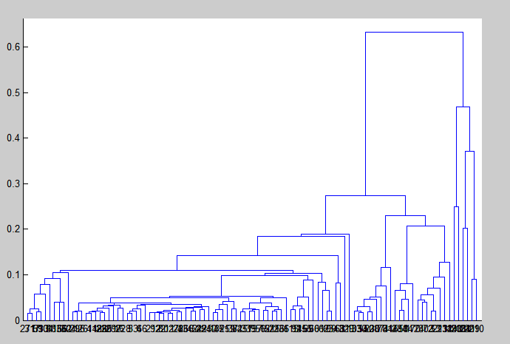
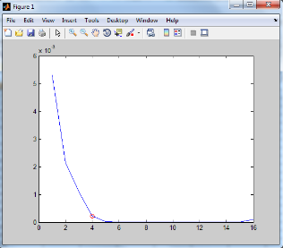
Hierarchical Clustering
Perform hierarchical clustering on the distance matrix obtained from trajectory similarity.
Evaluate a good measure for defining goodness of a cluster
Devise a heuristic to stop at the optimal point
Heuristic to find optimal number of clusters
Similarity Matrix
Final Clusters
Dendrogram
Elbow Curve
M.S First Seminar

Slide 23
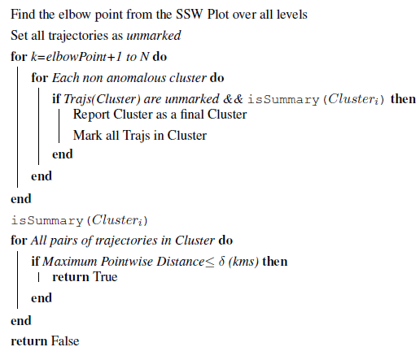
Finding the optimal number of Clusters
M.S First Seminar

Slide 24
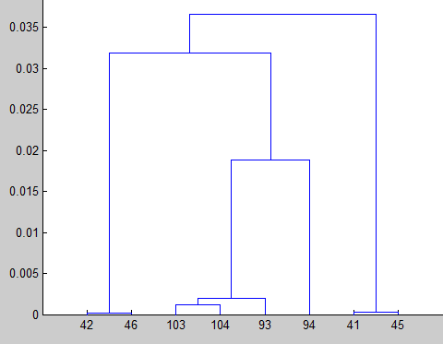
Optimal Cluster No. – Heuristic Explained…
Two Clusters
isSummary
isSummary
No
Yes
Go down the dendrogram
Final Cluster
M.S First Seminar

Slide 25
Experimentation
Comparisons with DTW
M.S First Seminar

Slide 26
Comparisons with DTW Similarity
DTW is not a metric as it violates triangle inequality –
Might affect the clusters formed in hierarchical clustering
DTW is computationally much more expensive
As the noise increases, effectiveness of DTW goes down much faster when compared to proposed method.
M.S First Seminar

Slide 27
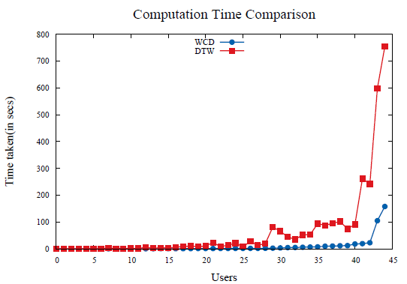
Comparisons with DTW Similarity
M.S First Seminar

Slide 28
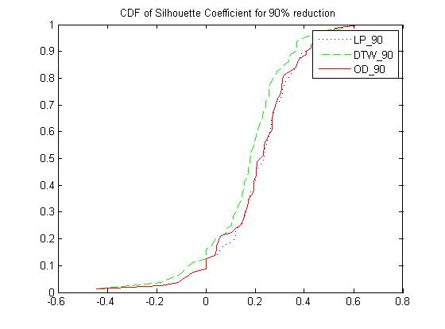
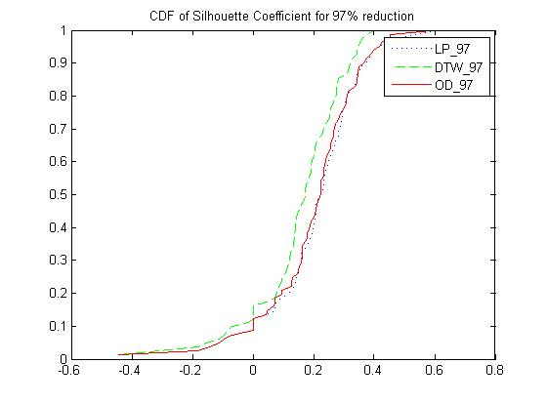
Comparisons with DTW Similarity
CDF for SC with 90% reduction in sample points
CDF for SC with 97% reduction in sample points
M.S First Seminar

Slide 29
Experimentation
Proposed Method- Visualizations
M.S First Seminar

Slide 30
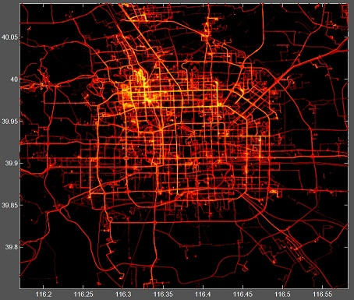
Dataset
Geolife Dataset –
182 users
Over a period of over four years (from April 2007 to October 2011)
17,621 trajectories
Around Beijing
M.S First Seminar

Slide 31
Cluster 1
Cluster 2
All Trajectories
Cluster 3
Cluster 4
Visualizations at Elbow Point
M.S First Seminar

Slide 32
Final Clusters
M.S First Seminar

Slide 33
Conclusion
M.S First Seminar

Slide 34
Conclusion
From a raw source of GPS traces, aim is to find the Mobility Summary of the individual
Steps: Preprocessing, defining a Similarity, and Clustering.
Applications of Mobility Summary:
Next Path Prediction
Anomaly Detection
Future Work:
Coming up with a better heuristic to find optimal number of clusters
Trajectory Summarization
Applications of Mobility Summary
Publication- Accepted (Demo) -TrajSummary: Mobility Summary of Individuals, COMSNETS 2016
M.S First Seminar

Slide 35
Future Work
Trajectory Preprocessing
Trajectory Similarity Analysis
Trajectory Clustering
Trajectory Summarization
Applications of Mobility Summary
M.S First Seminar

Slide 36
Thank You!
M.S First Seminar

Slide 37
References
M.S First Seminar

Slide 38
R. Agrawal, C. Faloutsos, and A. Swami. Efficient similarity search in sequence databases. 1994.
D. J. Berndt and J. Clifford. Finding patterns in time series, advances in knowledge discovery and data mining. In The Thirteenth National Conference on Artificial Intelligence,AAAI, Portland, Oregon, August 4- 8, 1996. MIT Press.
K. Buchin, M. Buchin, J. Gudmundsson, M. L¨offler, and J. Luo. Detecting commuting patterns by clustering subtrajectories. International Journal of Computational Geometry & Applications, 21(03):253–282, 2011.
K. Buchin, M. Buchin, M. Van Kreveld, M. L¨offler, R. I. Silveira, C. Wenk, and L. Wiratma. Median trajectories. Algorithmica, 66(3):595–614, 2013.
L. Chen and R. Ng. On the marriage of lp-norms and edit distance. In Proceedings of the Thirtieth International Conference on Very Large Data Bases - Volume 30, VLDB ’04, pages 792–803, Toronto, Canada, 29 August - 3 September 2004. VLDB Endowment.
L. Chen, M. T. O¨ zsu, and V. Oria. Robust and fast similarity search for moving object trajectories. In Proceedings of the 2005 ACM SIGMOD International Conference on Management of Data, SIGMOD ’05, pages 491–502, Baltimore, Maryland, June 13-17, 2005. ACM.
S. Gaffney and P. Smyth. Trajectory clustering with mixtures of regression models. In Proceedings of the fifth ACM SIGKDD international conference on Knowledge discovery and data mining, pages 63–72, San Diego, CA, USA, August 15 - 18,1999. ACM.
J. Gudmundsson, M. van Kreveld, and B. Speckmann. Efficient detection of patterns in 2d trajectories of moving points. Geoinformatica, 11(2):195–215, 2007.
B. Han, L. Liu, and E. Omiecinski. Neat: Road network aware trajectory clustering. In Distributed Computing Systems (ICDCS), 2012 IEEE 32nd International Conference on, pages 142–151, Macau,China, 18-21 June,2012. IEEE.
M.S First Seminar

Slide 39
S. Kurtek, A. Srivastava, E. Klassen, and Z. Ding. Statistical modeling of curves using shapes and related features. Journal of the American Statistical Association, 107(499):1152–1165, 2012.
J.-G. Lee, J. Han, and K.-Y. Whang. Trajectory clustering: A partition-and-group framework. In Proceedings of the 2007 ACM SIGMOD International Conference on Management of Data, SIGMOD ’07, pages 593–604, Beijing, China, June 11 - 14, 2007. ACM.
Q. Li, Y. Zheng, X. Xie, Y. Chen,W. Liu, andW.-Y. Ma. Mining user similarity based on location history. In proceedings of the 16th ACM SIGSPATIAL international conference on Advances in geographic information systems, Irvine, CA, USA, November 5-7, 2008. ACM.
Z. Li, B. Ding, J. Han, and R. Kays. Swarm: Mining relaxed temporal moving object clusters. Proc. VLDB Endow., 3(1-2):723–734, Sept. 2010.
M. K. E. Mahrsi and F. Rossi. Modularity-based clustering for network-constrained trajectories. arXiv preprint arXiv:1205.2172, 2012.
M. Nanni and D. Pedreschi. Time-focused clustering of trajectories of moving objects. Journal of Intelligent Information Systems, 27(3):267–289, 2006.
H. Su, K. Zheng, K. Zeng, J. Huang, S. Sadiq, N. J. Yuan, and X. Zhou. Making sense of trajectory data: A partition-and-summarization approach. In IEEE 31st International Conference on Data Engineering (ICDE), pages 963–974, Seoul, South Korea, 13 Apr - 17 Apr, 2015. IEEE.
M. Vlachos, G. Kollios, and D. Gunopulos. Discovering similar multidimensional trajectories. In Proceedings of the 18th International Conference on Data Engineering, pages 673–684, San Jose, CA, 26 February - 1 March, 2002.
M.S First Seminar

Slide 40
H.Wang, H. Su, K. Zheng, S. Sadiq, and X. Zhou. An effectiveness study on trajectory similarity measures. In Proceedings of the Twenty-Fourth Australasian Database Conference-Volume 137, pages 13–22, Adelaide, Australia, 2013. Australian Computer Society, Inc.
B.-K. Yi and C. Faloutsos. Fast time sequence indexing for arbitrary lp norms. Cairo, Egypt, September 10-14, 2000. VLDB.
B.-K. Yi, H. Jagadish, and C. Faloutsos. Efficient retrieval of similar time sequences under time warping. In proceedings of the Fourteenth International Conference on Data Engineering, ICDE, pages 201–208, Orlando, Florida, USA, February 23-27, 1998.
J. Yuan, Y. Zheng, X. Xie, and G. Sun. T-drive: Enhancing driving directions with taxi drivers’ intelligence. Knowledge and Data Engineering, IEEE Transactions on, 25(1):220–232, Jan 2013.
P. Zhang, M. Deng, and N. Van deWeghe. Clustering spatio-temporal trajectories based on kernel density estimation. In Computational Science and Its Applications–ICCSA 2014, pages 298–311. Springer, Guimaraes, Portugal, June 30 - July 3, 2014.
Y. Zheng. Trajectory data mining: an overview. ACM Transactions on Intelligent Systems and Technology (TIST), 6(3):29, 2015.
Y. Zheng, Y. Chen, X. Xie, and W.-Y. Ma. Geolife2.0: A location-based social networking service. In Mobile Data Management: Systems, Services and Middleware, 2009. MDM ’09. Tenth International Conference on, pages 357–358, Taipei, Taiwan, May May 18- May 21, 2009.
Y. Zheng, Q. Li, Y. Chen, X. Xie, and W.-Y. Ma. Understanding mobility based on gps data. In Proceedings of the 10th International Conference on Ubiquitous Computing, UbiComp ’08, pages 312–321, New York, NY, USA, 2008. ACM.
M.S First Seminar

Slide 41
H.Wang, H. Su, K. Zheng, S. Sadiq, and X. Zhou. An effectiveness study on trajectory similarity measures. In Proceedings of the Twenty-Fourth Australasian Database Conference-Volume 137, pages 13–22, Adelaide, Australia, 2013. Australian Computer Society, Inc.
B.-K. Yi and C. Faloutsos. Fast time sequence indexing for arbitrary lp norms. Cairo, Egypt, September 10-14, 2000. VLDB.
B.-K. Yi, H. Jagadish, and C. Faloutsos. Efficient retrieval of similar time sequences under time warping. In proceedings of the Fourteenth International Conference on Data Engineering, ICDE, pages 201–208, Orlando, Florida, USA, February 23-27, 1998.
J. Yuan, Y. Zheng, X. Xie, and G. Sun. T-drive: Enhancing driving directions with taxi drivers’ intelligence. Knowledge and Data Engineering, IEEE Transactions on, 25(1):220–232, Jan 2013.
P. Zhang, M. Deng, and N. Van deWeghe. Clustering spatio-temporal trajectories based on kernel density estimation. In Computational Science and Its Applications–ICCSA 2014, pages 298–311. Springer, Guimaraes, Portugal, June 30 - July 3, 2014.
Y. Zheng. Trajectory data mining: an overview. ACM Transactions on Intelligent Systems and Technology (TIST), 6(3):29, 2015.
Y. Zheng, Y. Chen, X. Xie, and W.-Y. Ma. Geolife2.0: A location-based social networking service. In Mobile Data Management: Systems, Services and Middleware, 2009. MDM ’09. Tenth International Conference on, pages 357–358, Taipei, Taiwan, May May 18- May 21, 2009.
Y. Zheng, Q. Li, Y. Chen, X. Xie, and W.-Y. Ma. Understanding mobility based on gps data. In Proceedings of the 10th International Conference on Ubiquitous Computing, UbiComp ’08, pages 312–321, New York, NY, USA, 2008. ACM.

Slide 42
Y. Zheng, Q. Li, Y. Chen, X. Xie, and W.-Y. Ma. Understanding mobility based on GPS data. In Proceedings of the 10th international conference on Ubiquitous computing, pages 312–321, Seoul, South Korea, September 21 - 24, 2008. ACM.
Y. Zheng and X. Xie. Learning travel recommendations from user-generated GPS traces. ACM Transactions on Intelligent Systems and Technology (TIST), 2(1):2, 2011.
Y. Zheng, X. Xie, and W.-Y. Ma. Geolife: A collaborative social networking service among user, location and trajectory. IEEE Data Eng. Bull., 33(2):32–39, 2010.
Y. Zheng, L. Zhang, X. Xie, and W.-Y. Ma. Mining interesting locations and travel sequences from GPS trajectories. In Proceedings of the 18th international conference on World wide web, pages 791–800, Madrid, Spain, April 20 - 24, 2009. ACM.

